Slide 1

Computer Organization
Chapter 9 Controller

Slide 2
Chapter 9 Controller
9.1 Function and organize of controller
9.2 Basic concept
9.3 Time-series generator and its control mode
9.4 Combinatorial logistic controller
9.5 Micro-program controller

Slide 3
9.1 Function and organize of controller
Functions of controller
  control CPU
  control Memory
  control I/O
Design trend
  Input, output and memory are using asynchronous control, do not rely on the central clock
  Using the distribution control, do not centralized control
  Using micro-program

Slide 4
9.1 Function and organize of controller
Functions of controller
1、fetch instruction
  generate the address of next instruction in memory
  The working process of a computer: loop for fetch instruction-analysis instruction-execute instruction；
  Power on→generate reset signal→execute program→hall→power off
∴the main task of controller is to ensure instruction working in a safe and regular way

Slide 5
9.1 Function and organize of controller
2、analysis instruction
  Analysis the instruction that has been fetched. Give corresponding commands. Generate the address of operand if necessary.
3、execute instruction
  Generate operation signal sequence according to operand and opcode. Based on CPU and I/O, every instruction can be executed, which include calculation the result and generation of the address of the next instruction.

Slide 6
9.1 Function and organize of controller
  Program and data are importing to computer. The result is exporting. The abnormal thing is needed to be handled. Interaction is needed between human and computer.
4、Control input of program and date and output of result
  Send commands to I/O system according program or human interface.

Slide 7
9.1 Function and organize of controller
5. Deal with abnormality and some request
The abnormality is send by the following devices:
  (1) Interrupt request. When CPU has finished the current instruction, it turn to interrupt. Then back to program to execute the next instruction.
  (2)DMA request. When CPU finished the current machine cycle, it is paused and give the bus to I/O device. The CPU rework at the point which it has suspended.
  DMA operation guarantee that the status of register in CPU is unchanged.

Slide 8
9.1 Function and organize of controller
organize of controller
1. program counter (PC)
Used to store the address of current instruction or the address of next instruction that to be executed.
2. Instruction register (IR)
Used to store the instruction that being executed.

Slide 9
9.1 Function and organize of controller
3. Instruction decoder
Analysis the opcode, and generate command signal.
4. Pulse and start-stop circuit
Pulse source generate pulse signal in a fixed frequency, and used for the clock. The clock is the basis of machine cycle and working pulse. There are also a reset signal to control the start and stop of the machine.

Slide 10
9.1 Function and organize of controller
5. time control signal generating device
After the computer is started, according to the CLK and the executing instruction, the time control signal is generated. And it can be adjusted due to feedback of the controlled parts.

Slide 11
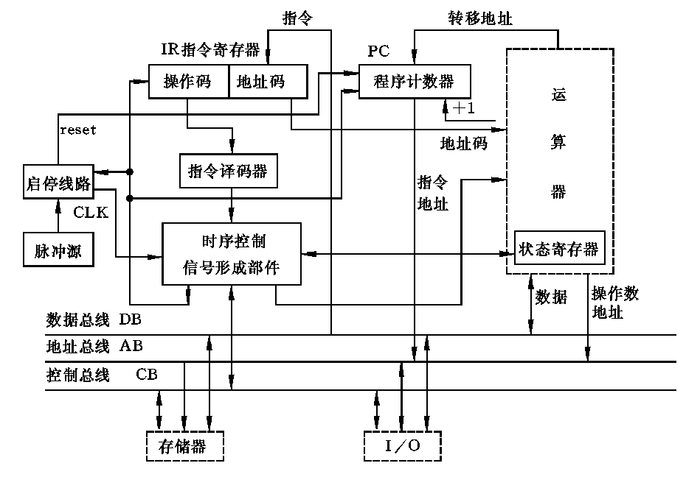
9.1 Function and organize of controller

Slide 12
9.1 控制器的功能和一般组织
C=f(Im,Mi,Tk,Bj)
微操作控制信号
来自执行部件的反馈信息Bj
…
C1
Cn
逻辑网络N的输出信号就是微操作控制信号，它用来对执行部件进行控制。
B1
树形逻辑网络
N
…
Bj
I1
指令
译码器
…
Im
来自指令操作码（OP）译码器的输出Im；
IR
M1
…
Mi
T1
…
Tk
指令寄存器
启动
节拍电位/节拍脉冲发生器
来自时序产生器的时序信号，包括节拍电位信号M和节拍脉冲信号T
停止
时钟
复位

Slide 13
9.1 Function and organize of controller
Registers in CPU:
  IR（指令寄存器）；
  PC（程序计数器）；
  AC（累加寄存器）；
  PSR（程序状态寄存器）；
  MAR（地址寄存器）；
  MDR or MBR（数据缓冲寄存器）

Slide 14
9.2 Basic concept of controller
1、Instruction cycle
  The time from fetch instruction to the end of the operation of instruction.
  two stages——fetch and execute
2、 machine cycle（CPU周期）
  An instruction cycle is comprises of some machine cycle. Each machine cycle is in charge of a basic operation，i.e. fetch instruction, fetch oprands, execute, interrupt.
  Generally speaking, an instruction at least includes two machine cycles: fetch and execute.
  The machine cycle is defined as the cycle for memory fetch Tm.

Slide 15
9.2 Basic concept of controller
3、beat（clock cycle,T）
  A machine cycle is composed of some time interval. Each interval is called a beat. A beat is a ele-bit signal, which controls one or some micro controls
  The smallest time part for computer operation.
relationships：
T
CPU cycle
(fetch)
CPU cycle
(execute)
Instr-cycle

Slide 16
9.2 Basic concept of controller
4、Basic process of execution:
  FIC（取指周期）
  FDC（取数周期）
  EXEC（各种执行周期）
  DMAC （DMA周期）
  INTC（中断周期）
Check for DMA request after machine cycle
Check for INT request after execution cycle
T
CPU cycle
(fetch)
CPU cycle
(execute)
Instr-cycle

Slide 17
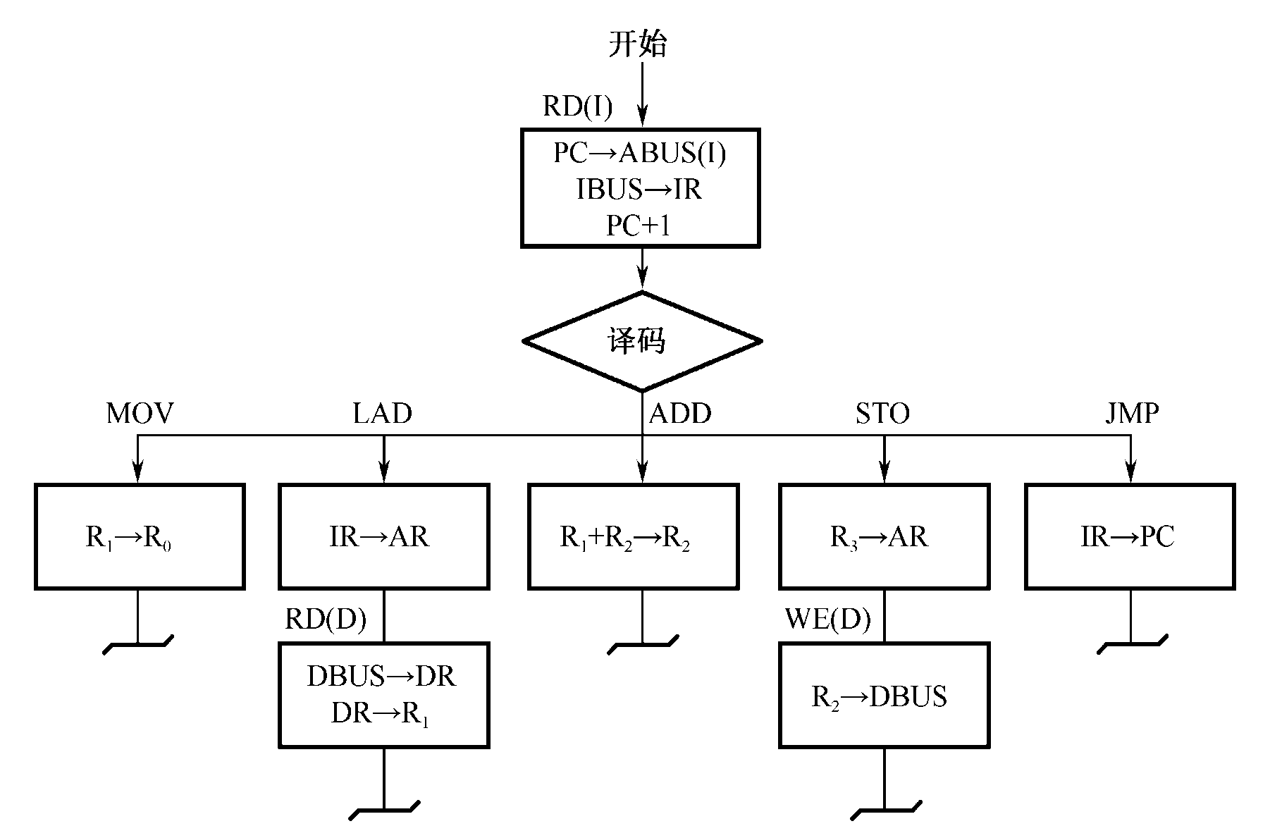
9.2 Basic concept of controller
5、Using block diagram to represent instruction cycle:
  方框——按CPU周期
  菱形符号——判别或测试
  内容——数据通路操作或控制操作
取指
执行
  ~ — 公操作

Slide 18
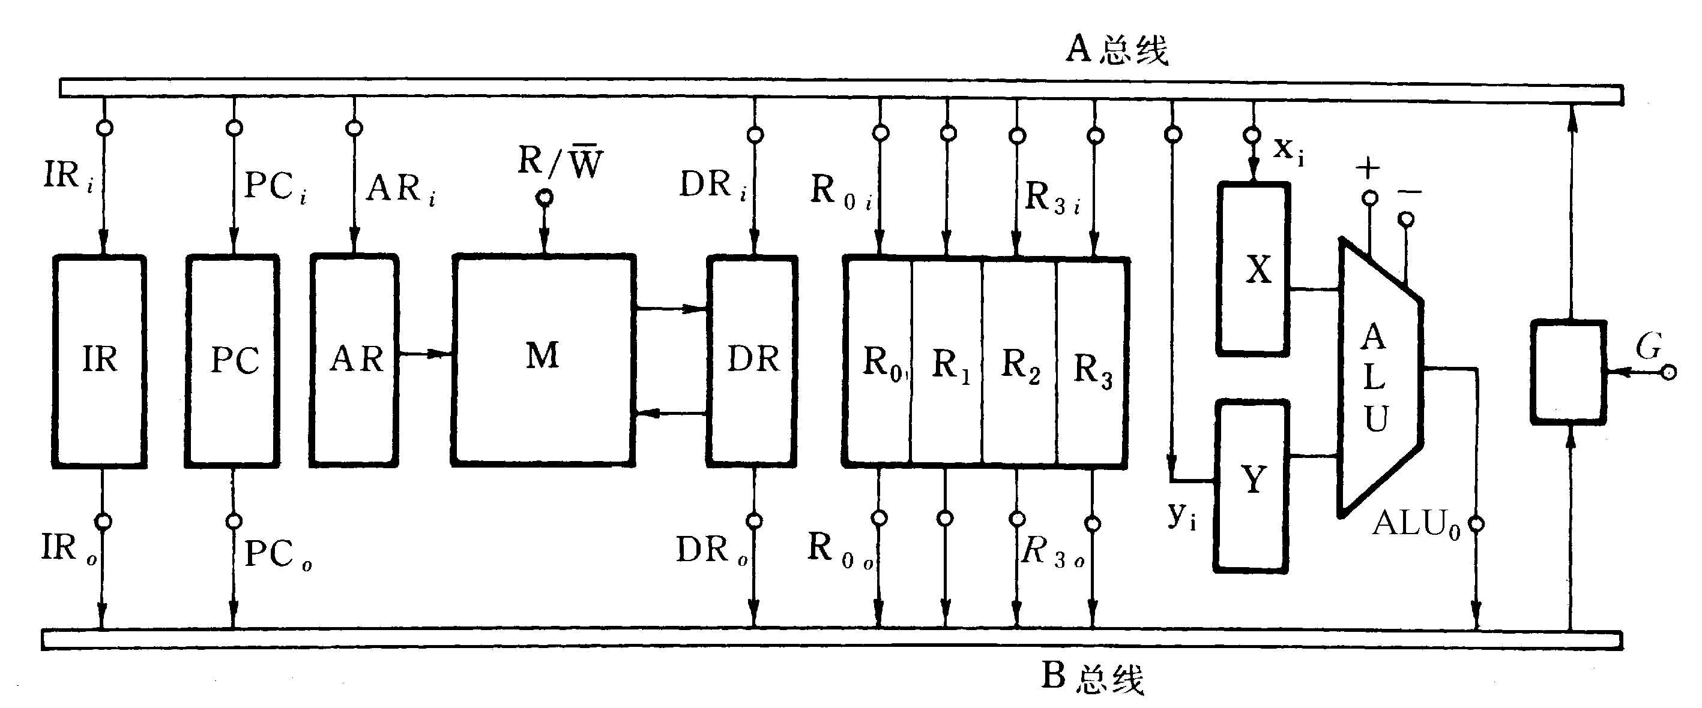
9.2 Basic concept of controller
5、Using block diagram to represent instruction cycle:
Example
微操作信号
微操作信号
双总线结构机器的数据通路图

Slide 19
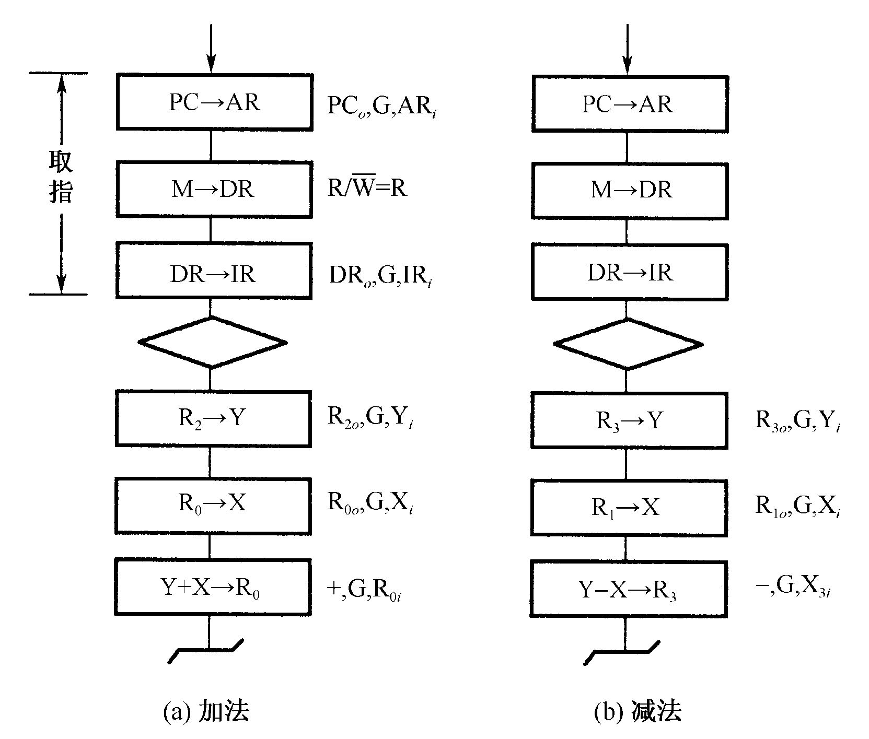
9.2 控制器的基本概念
ADD R0，R2 指令完成
(R0)+(R2)→R0的功能操作
SUB R3，R1 指令完成
(R3)-(R2)→R0的功能操作

Slide 20
9.3 Time-series generator and its control mode
1、function of Time-series signal
[Thinking]: How to recognize binary code is data or instruction?
  Time: Fetch instruction occurs in the first CPU cycle of instruction cycle. Fetch data occurs in the follow up CPU cycles.
  space: If the code that fetched is instruction, then the datapath is from DR to IR. If the code that fetched is data, then it is send to ALU.
时间控制对计算机来说是非常重要的！

Slide 21
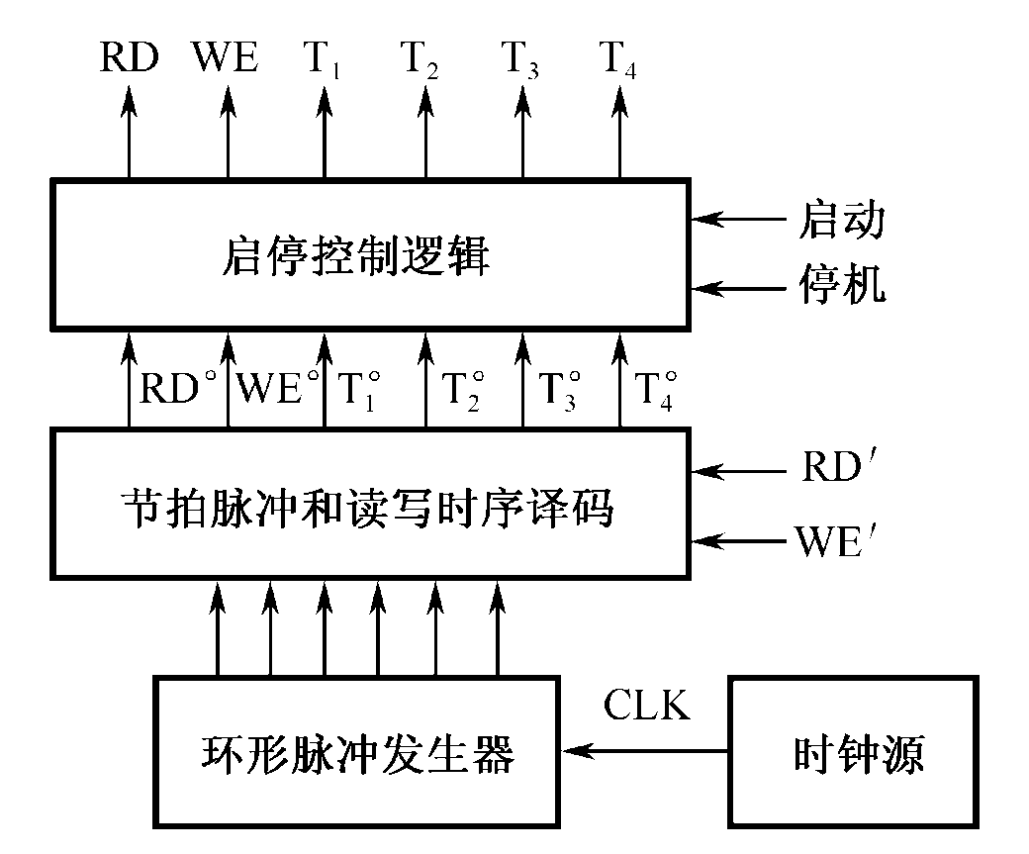
9.3 Time-series generator and its control mode
2、Time-series generator
The computer is regulated by time symbol, which is realized by time series signal.
composition：
  clock generator;
  circular pulse generator ;
  pulse beat, r/w time series decoder logic
  start/stop control logic

Slide 22
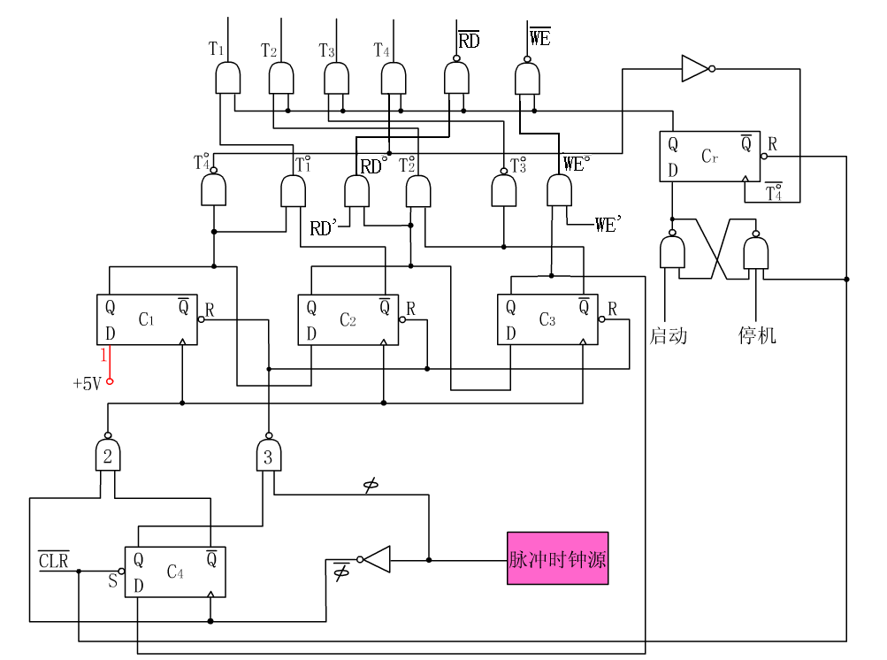

中央处理器
T₄⁰的下降沿采样
启/停信号的状态

Slide 23
1 2 3 4 5 6 7 8 9 10 11 12 13 14 15
Φ
Φ
C₄
C₁
C₂
C₃
RD’
RD^{O}=C₂•RD’
RD
WE’
WE^{O}=C₃•WE’
T₁^{O}=C₁•C₂
WE
T₂^{O}=C₂•C₃
T₁
T₃^{O}=C₃
T₂
T₃
T₄^{O}=C₁
T₄
CPU周期
CPU周期
CPU周期

Slide 24
9.4 hard wired controller
1、implementation
  Through the logic circuit, which is also known as combinational logic control mode
2、design goal
  using minimal devices （network of complex tree）
  highest speed

Slide 25
9.4 hard wired controller
微操作控制信号
来自执行部件的反馈信息Bj
…
C1
Cn
逻辑网络N的输出信号就是微操作控制信号，它用来对执行部件进行控制。
B1
树形逻辑网络
N
…
Bj
I1
指令
译码器
…
Im
来自指令操作码（OP）译码器的输出Im；
IR
M1
…
Mi
T1
…
Tk
指令寄存器
启动
节拍电位/节拍脉冲发生器
来自时序产生器的时序信号，包括节拍电位信号M和节拍脉冲信号T
停止
时钟
硬布线控制器的基本原理：
C=f(Im,Mi,Tk,Bj)
复位
硬布线控制器结构方框图

Slide 26
9.4 hard wired controller
3、micro control signal generator
  Micro control signals are generated by output function of Boolean algebra expression.
  specific method and process:
    according to diagram of all machine instruction, find all the conditions of generating the same micro control signal.
    Then combined with appropriate impulse beat, give its Boolean algebra expression.
    After simplification, it can be realized by gate circuit or programmable logic devices.

Slide 27
9.4 hard wired controller
4、design steps:
  （1）draw sequence of instruction
  （2）list the time table of micro operation
    Arrange the micro operation in sequence diagram into corresponding beat and impulse of every machine cycle.
    Time table of micro operation shows: when, which condition, which micro control signals are sending.

Slide 28
9.4 hard wired controller
（3）composition of micro operation signal
  After list micro operation time table of all instruction，it needs analysis. Considering all conditions (which instruction, which machine cycle, which beat and impulse) of execute one micro control. With classification，logic expression of each micro control can be generated. Finally，it is simplified so that a reasonable expression can be gained.
（4）realize circuit 
  According to the set of logic expression, it can be implemented by a series of logic circuits. Logic circuit can be drawn on the basis of logic expression with composition of logic gate circuit. It can also be implemented by PLA or other logic circuit according to logic expression.

Slide 29
9.4 hard wired controller
例：
LdAR, Rd(I), LdDR, LdIR, PC+1, LdPC
M1
取指
M2
LdR0
LdAR
Rd(D)
LdR2
LdAR
LdPC
M3
LdDR,
LdR1
WE(D)

Slide 30
9.4 hard wired controller
According to diagram，gives the logic expression of the following control signals RD(I)、RD(D)、WE(D)、LDPC、LDIR、LDAR、LDDR、PC+1、LDR2. Their means are:
  RD（I）—指存读命令
  RD（D）—数存读命令
  WE（D）——数存写命令
  LDPC—打入程序计数器
  LDIR—打入指令寄存器
  LDAR—打入数存地址寄存器
  LDDR—打入数据缓冲寄存器
  PC+1—程序计数器加1
  LDR1, LDR2—打入RI寄存器

Slide 31
9.4 硬布线控制器
节拍 电位 | 脉 冲 | LDAR | LDDR | LDIR
M1 | T1
 | T2 | MOV、LAD、ADD、STO、JMP
 | T3 |  | MOV、LAD、ADD、STO、JMP
 | T4 |  |  | MOV、LAD、ADD、STO、JMP
M2 | T1
 | T2
 | T3
 | T4 | LAD、STO
M3 | T1
 | T2
 | T3 |  | LAD
 | T4

Slide 32
9.4 hard wired controller
composition of micro control signal
Ex:
LDAR=M1·T2+M2· (LAD+STO)·T4
LDDR=M1·T3+M3· (LAD)·T3
LDIR=M1·T4
where M1, M2, M3 are three impulse beats. T3 and T4 are clock cycle signal. ADD, STO, JMP are output signal of OP part in instruction.
Finally circuit is given.

Slide 33
9.5 micro program controller
history
  Proposed by prof. M·V·Wilkes in 1951 in conf. of computer in Manchester University. At that time there is no store device for micro program.
  In 1964，IBM realizes micro program tech. in 360 series computer.
  In 1970s，the development of VLSI promotes the micro program technology.
  Nowadays, most computer adopt micro program tech.

Slide 34
9.5 micro program controller
basic idea
  Form micro control signals into micro instruction. And store them into control memory.
  When the computer is running, the micro-instruction is fetched and send the micro control signals to their appropriate places.
  It is a method that using software to replace hardware.

Slide 35
9.5 micro program controller
concept: micro-command and mirco-operate
micro-command：Control command that control parts sending to execute parts, which is the smallest unit forming control sequence.
  i.e ：a voltage signal to open or close a gate .
  i.e ：a pulse signal to control writing a register
micro-operate: operation process of mirco-command
  It is corresponded to a specific micro-command
  Micro-operation is a basic operation in the implementation of the components

Slide 36
9.5 micro program controller
mirco-operations can be divided into two kinds: inclusive and exclusive(相容和互斥)
  Exclusive: micro controls that could not be performed in parallel or in one clock beat. It can be coded.
  Inclusive: micro controls that could be performed simultaneously or in one clock beat. It can not be coded, and it must be occupy one bit.
Ex:

Slide 37
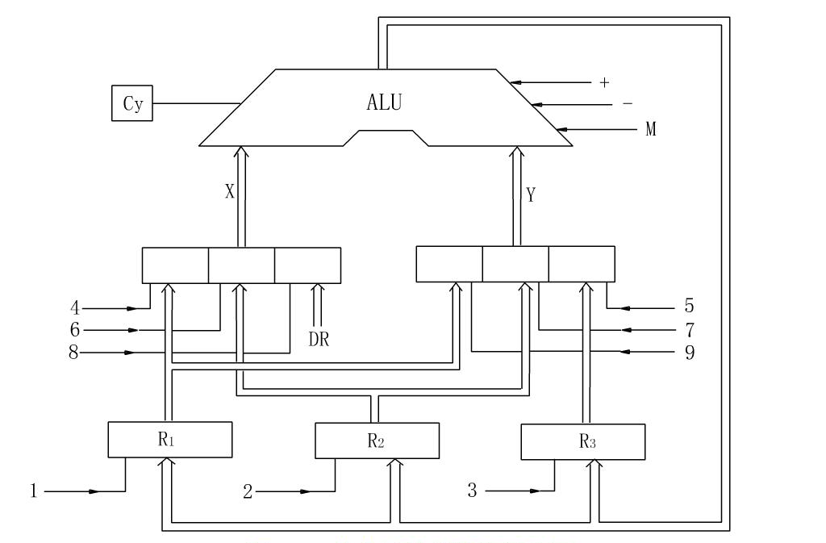
9.5 micro program controller
inclusive and exclusive(相容和互斥)

Slide 38
9.5 micro program controller
3. micro-instruction: The all micro-operation information that can be executed in one CPU cycle, which is stored in memory, is called micro-instruction.
  Consist of micro-commands. Stored in control memory(控制存储器)
  A micro-instruction includes two kinds of information:
    micro-operation field(操作控制字段), is also called micro-opcode field(微操作码字段). It can generate every micro-control signal for next step.
    Sequence control field(顺序控制字段)，is also called micro-address field(微地址码字段). It can generate the address of the next m-instruction.

Slide 39
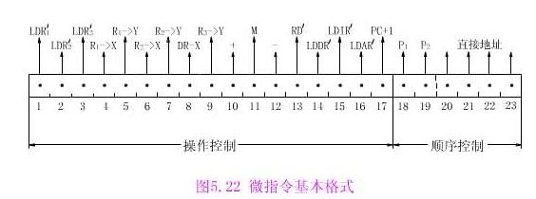
9.5 micro program controller
The micro-instruction format

Slide 40
9.5 micro program controller
4、micro-program (微程序)
  A set of micro-instructions constitute micro-program
  A segment of micro-program corresponds to a instruction.
主存
控存
┇
┇
1
i
i+1
ADD指令
的微程序
求
解
问
题
的
算
法
┇
┇
ADD R1，R2·
┇
STA M1
┇
┇
STA指令
的微程序
┇
m
┇
┇

Slide 41
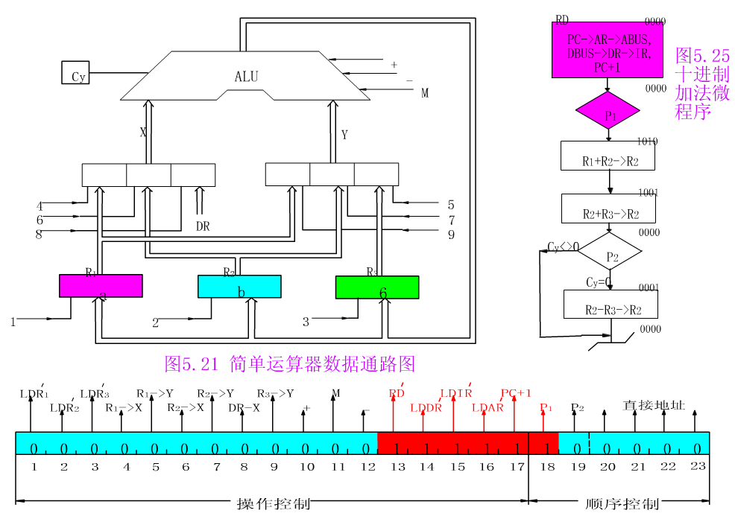
9.5 微程序控制器
举例

Slide 42
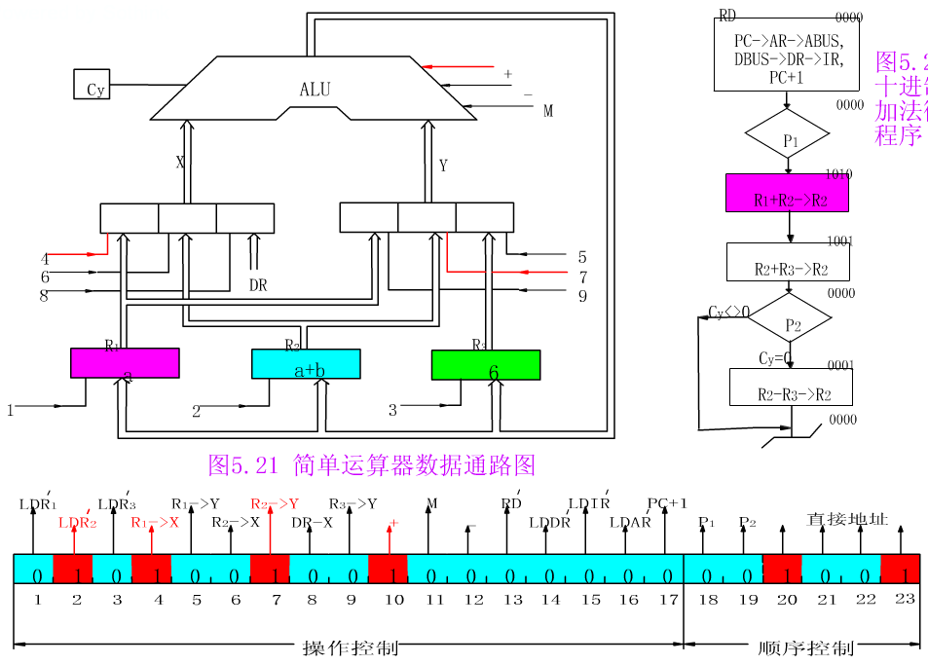

Slide 43
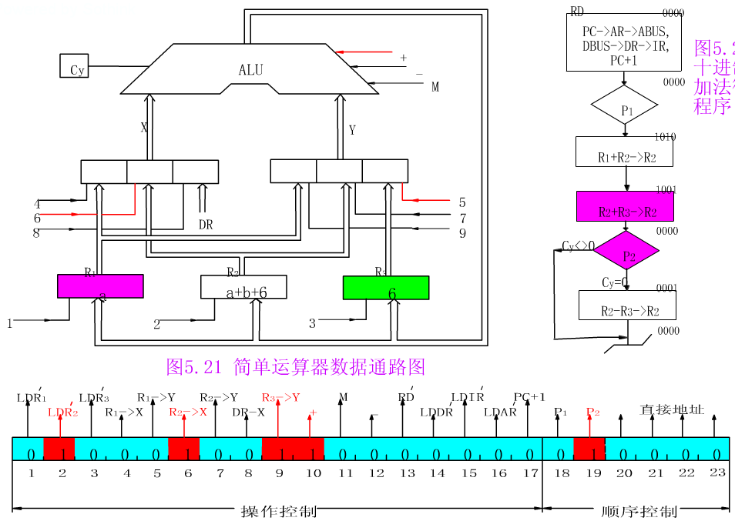

Slide 44
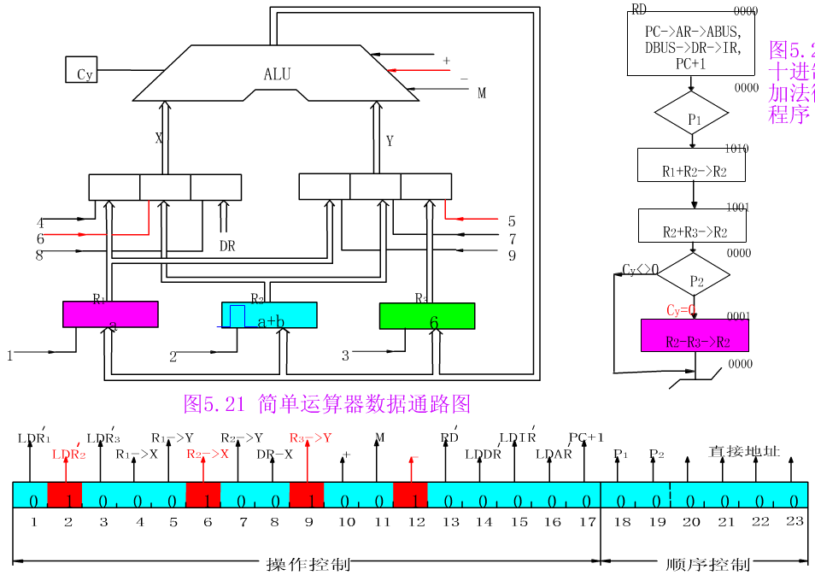
微程序：
中央处理器

Slide 45
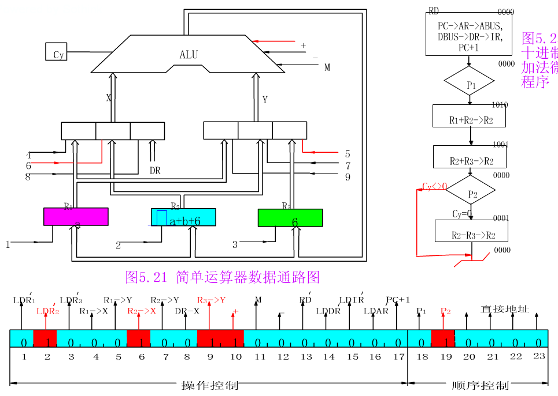

Slide 46
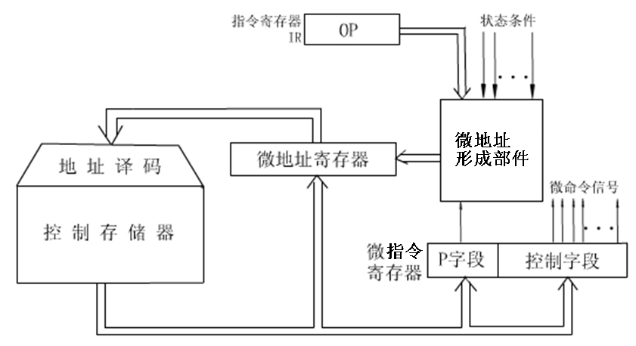
9.5 micro program controller
Principles of micro-program controller

Slide 47
9.5 micro program controller
working process of mirco-program controller
(1)Common operation: fetching instruction.
When the computer runs, it send the address of fetch mirco-program to μMAR. Then read mirco-instruction from μCM and sent it to μIR. Control part in mirco-operate of mirco-instruction generate mirco-commands, which used for implement fetching instruction.
The entrance address of fetch mircro-program is generally 0 of μCM. When fetching mirco-program is finished, mirco-instruction that fetched from main memory is stored in IR.
(2the opcode of IR can generate entrance address of mirco-program and send it to μMAR.

Slide 48
9.5 micro program controller
(3)Read micro-instruction one by one from μCM and execute it. Each micro-instruction can generate the next mirco-instruction automatically.
(4)After the last mirco-instruction of mirco-program that corresponds to a machine instruction is finished, the address of next mirco-instruction is back to entrance address of mirco-program fetching part. Then loop for step (1) so as to complete the common part of the next instruction.
The above is the whole process of executing an instruction. And loop for all instructions of a program is finished.

Slide 49
9.5 micro program controller
relationship between CPU cycle and m-instruction cycle
┇
┇
1
i
i+1
ADD指令
的微程序
求
解
问
题
的
算
法
┇
┇
ADD R1，R2·
┇
STA M1
┇
┇
STA指令
的微程序
┇
m
┇
┇
主存
控存

Slide 50
9.5 micro program controller
goal for design m-instruction:
(1) reduce word length of mirco-instruction
(2) reduce size of control-memory
(3) increase execute speed of mirco-program
(4) easy to modify
(5) improve flexibility

Slide 51
9.5 micro program controller
design technology of mirco-program
    (1) coding mirco-operation
    (2) formation of mirco-address 微地址的形成方法
    (3) Formation of mirco-instruction 微指令格式

Slide 52
9.5 micro program controller
（1）coding mirco-operation
General formation of mirco-instruction is:
Coding mirco-operation
( the method of operation control field design)
3 methods:
  1. directly representation 直接表示法
  2. Coding representation 编码表示法
  3. Hybrid representation 混合表示法
Operating control field | Sequence control field

Slide 53
9.5 micro program controller
1. directly representation(直接表示法)
Each bit in control field represents one mirco-command
advantage : simply, intuitive, the output are directly used to control
disadvantage : word length is long. So size of control memory is large.
操作控制字段
……
……
顺序控制字段
微操作控制信号

Slide 54
9.5 micro program controller
2. coding representation(编码表示法)
Group a set of exclusive mirco-command. And using decoder to generate mirco-command signal, that is control signals.
reduce word length of mirco-instruction.
However, it needs decoder device, so the running speed is affected.
微命令
微命令
微命令
…
…
…
译码
译码
译码
…
…
……
微操作控制字段
顺序控制字段

Slide 55
9.5 micro program controller
3. Hybrid representation(混合表示法)
Hybrid of the above 2 methods.

Slide 56
9.5 micro program controller
（2）formation of micro-address
design for sequence control field
①confirm entrance address of micro-program
1. executing mirco-program of “fetch instruct cycle”
  Usually this mirco-program is stored in continuous units from CM starting from 0 or 1.
  A machine instruction is fetched and send to IR.
2. according to opcode of instruction, entrance address of mirco-program is given, which is a multi-branches.

Slide 57
9.5 micro program controller
② How to determine the address of the next mirco-instruction:
 1. counter (计数器方式)
2. multiway-branch (多路转移方式)

Slide 58
9.5 micro program controller
1. counter
Reference to counter in PC, we set a µPC.
Execute mirco-program in sequence, (µPC)+1→µPC;
When there exists branch, the new address is send to µPC according to mirco-instruction
characters：
  Word length is short. mirco-address generation unit is uncomplicated.
  Hard to branch. Address assignment of CM is not easy.

Slide 59
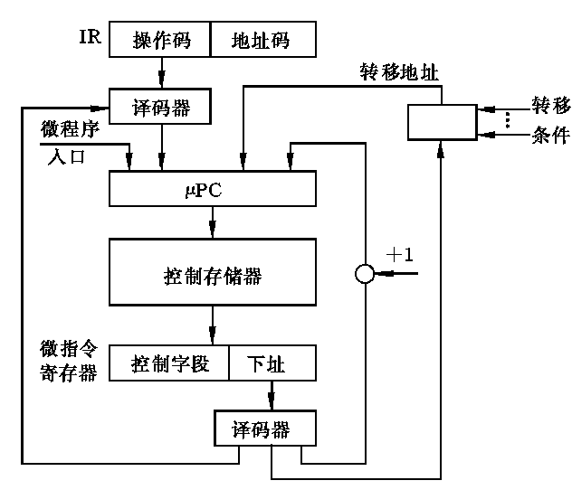
9.5 micro program controller
1. counter

Slide 60
9.5 micro program controller
2. multi-branches
The next address of mirco-instruct is determined by Identification field(测试判别字段).
mirco-instruction formation:
µOP
测试判别字段
下址

Slide 61
9.5 micro program controller
2. multi branches
Example:
The following is a mirco-program diagram. Each box is a mirco-instruction. A-P are their mirco-operation fields. The first branch is a 4 branches after fetch mirco-instruction, decided by IR1 and IR0. The second is a 2 branches, determined by Z.
Design sequence control field of mirco-program. Assign mirco-address for each mirco-instruction.

Slide 62
Branches:
A
（1）IR₁、IR₀
（2）Z
B
（1）
C
IR₁IR₀=00
IR₁IR₀=10
IR₁IR₀=11
IR₁IR₀=01
D
H
L
P
（2）
E
I
M
F
Z=0
J
Z=1
N
G
K
O

Slide 63
解: ○ fix sequence control field of m-instruction
(1)the bit numbers of the next address field——
A~P, 16 mirco-instructions, 16 mirco-address, 4 bits；
(2) The bit numbers of Identification field P —— 2 bits
  00——next address (取下地址)
  01——branch 1(IR1、IR0) modify last 2 bits
  10——branch 2-C_{z}（modify last 1 bit）
  11——null
µOP
测试条件P
下地址
○再考虑微地址的分配。微地址分配的关键是带有分支的微指令，为了简化地址修改逻辑，通常使带分支的微指令的下址字段被测试条件控制的那几位为全0。无转移时，微地址可任意分配，一般由小到大分配，将CM中没有分配的微地址分配到不同的微指令中去。

Slide 64
A
00
0001
0000（0）
根据IR1，IR0，修改µAR0和µAR1，做四路分支
根据运算结果状态位Cz,修改µAR0,做两路选择
B
00
0010
0001（1）
C
01
0100
0010（2）
IR₁IR₀=00
IR₁IR₀=01
IR₁IR₀=10
IR₁IR₀=11
0100（4）
0101（5）
0110（6）
0111（7）
D
00
0011
H
00
1000
L
00
1001
P
00
1001
0011（3）
1000（8）
E
10
1010
I
00
1011
M
00
1100
1001（9）
1010（10）
1011（11）
F
00
1101
J
00
1110
N
00
1111
1100（12）
1101（13）
1110（14）
G
00
0000
K
00
0000
O
00
0000
1111（15）

Slide 65
微指令
微地址
操作控制字段
顺序控制字段
二进制
十进制
微命令
判别测试
下地址
0000 A 00 0001
0001 B 00 0010
按OP转移
0010 C 01 0100
0011 E 10 1010
按Cz转移
0100 D 00 0011
0101 H 00 1000
由指令OP控制
0110 L 00 1001
0111 P 00 1001
1000 I 00 1011
1001 M 00 1100
1010 F 00 1101
由Cz控制
1011 J 00 1110
1100 N 00 1111
1101 G 00 0000
1110 K 00 0000
1111 O 00 0000

Slide 66
A
00000
B
00001
（1）
C
00010
IR₁IR₀=00
IR₁IR₀=01
IR₁IR₀=10
IR₁IR₀=11
D
00100
H
00101
L
00110
P
00111
（2）
E
00011
I
01011
M
01101
01000
01001
10000
10001
F
Z=0
J
N
C=0
Z=1
Q
C=1
01010
01100
01110
01111
G
K
O
R

Slide 67
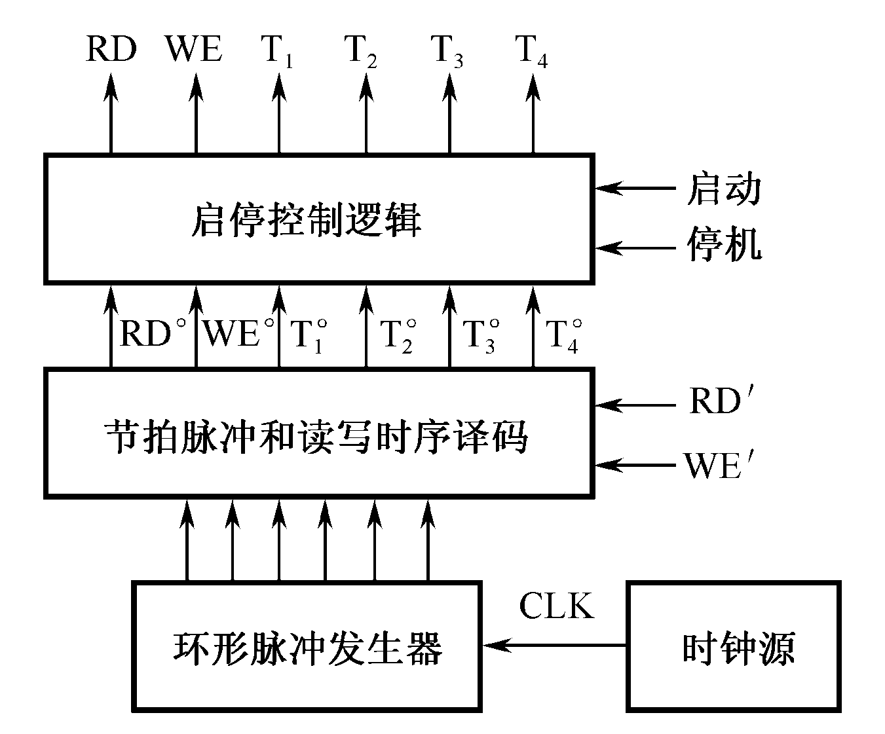
总结
9.1 控制器的功能和一般组织
9.2 控制器的基本概念
9.3 时序产生器和控制方式
9.4 硬布线控制器
9.5 微程序控制器
  1、指令控制（取指令）
  2、分析指令
  3、执行指令
  4、控制程序和数据的输入与结果输出
  5、对异常情况和某些请求的处理
  1、程序计数器(PC)
  2、指令寄存器(IR)
  3、指令译码器或操作码译码器
  4、脉冲源及启停线路
5、时序控制信号形成部件
T周期
CPU周期
(取指令)
CPU周期
(执行指令)
指令周期

